Slide 1
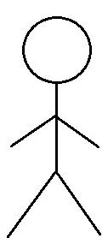
Use Case Diagram
Health App
Use Case Diagram
Module: 01. Account Management
Dietitians
1.1 Account Authentication
1.2 Account Summary
Fitness Enthusiastic
1.3 Customer Support
Fitness Trainer
Color Code
Support Representative
Implemented this semester

Slide 2
Use Case Diagram
Health App
Use Case Diagram
Module: 02. Fitness Tracking
2.1 List fitness routine
Dietitians
2.2 Track steps
User
2.3 Track calories
Fitness Trainer

Slide 3
Use Case Diagram
Health App
Use Case Diagram
Module: 03. Nutrition Tracking
3.1 List food nutrition
Dietitians
3.2 Track food intake
User
3.3 Modify food intake
3.4 Remove food intake
Fitness Trainer

